Slide 1

AhsanUllah university of science and technology Software Development Lab- 2200
Software Development Lab Project Presentation
Group: 10
Project Name: CGPA Calculator
Group Members:
Md. Yeasir Arafat
ID: 16.02.04.093
Noushin Tabassum
ID: 16.02.04.114

Slide 2

Cgpa calculator
A simple yet effective CGPA Calculator for University students. It is a faster & easier app to calculate CGPA in any android phone. You can easily add data to it’s database and also can delete data from database. It has also a complete user guide to show you how to use this app.

Slide 3
Features
Calculate CGPA
Database Connected
User friendly
History
A complete user guide

Slide 4
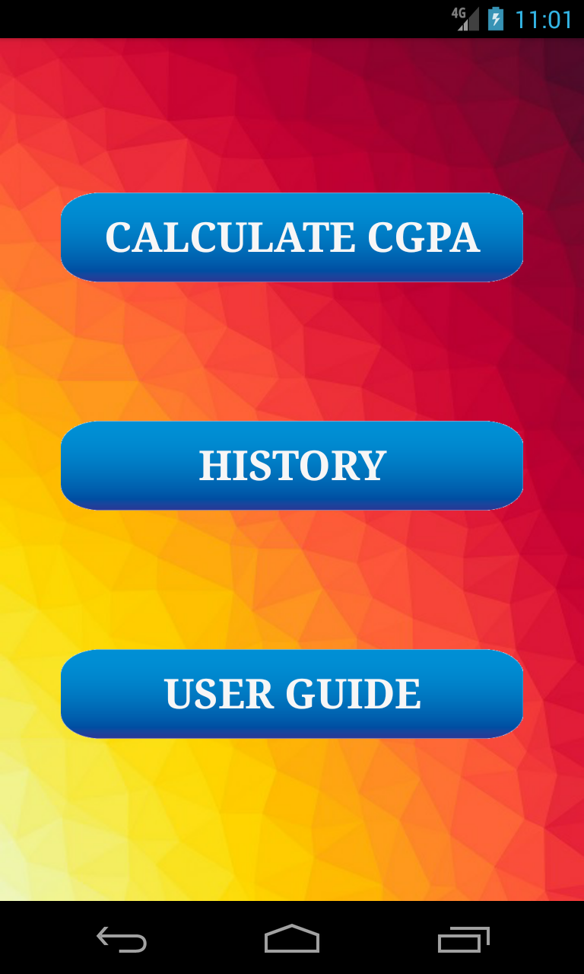
Welcome Page:
Buttons
Calculate CGPA
History
User Guide

Slide 5
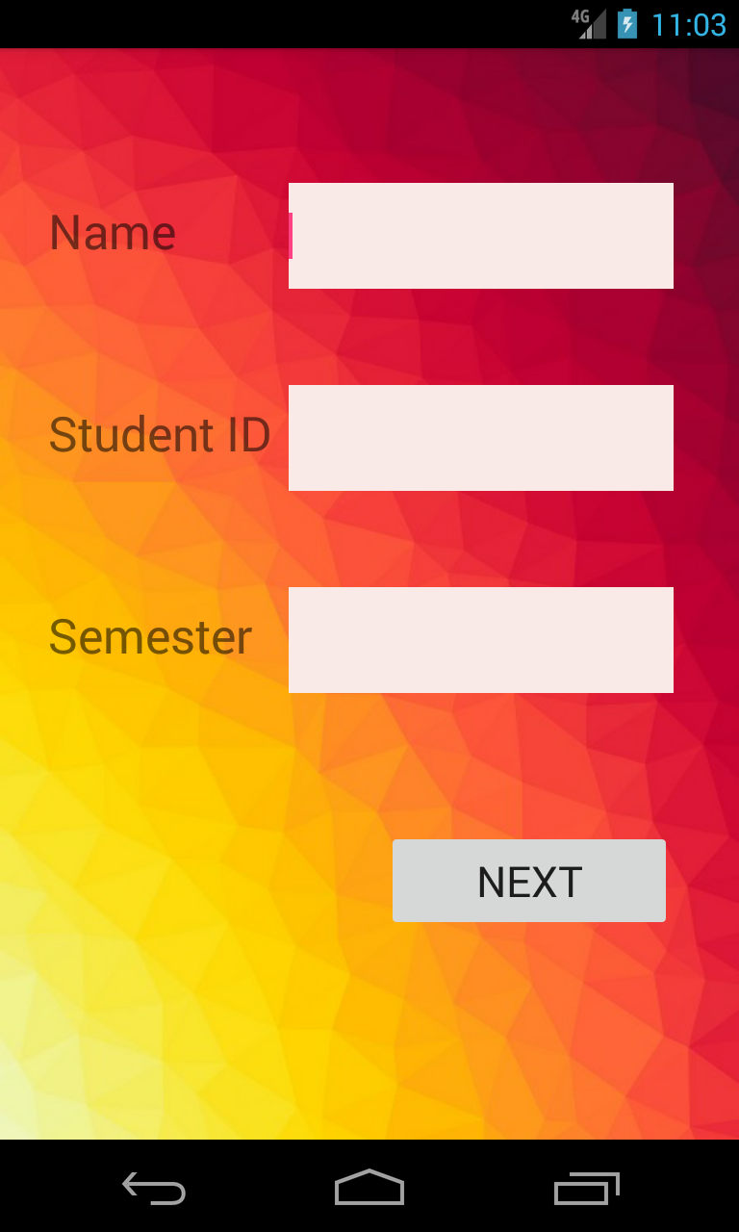
Register Page

Slide 6
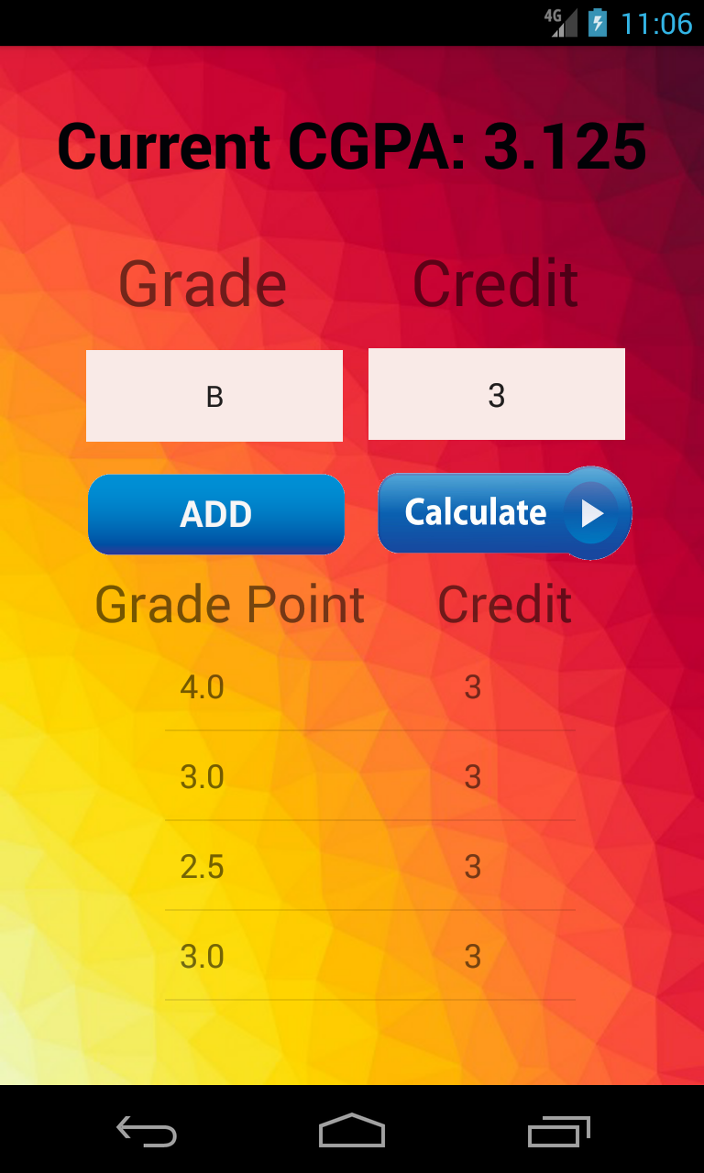
Calculation Page
For Calculate your CGPA you have to input values of Grade Point and Credit of a subject then if you press ADD button this subject will be ready for calculation and then you can add another subject. After adding all the subjects you have to press CALCULATE button. And now you can see your CGPA on the top of the screen. And history will be automatically saved in it’s Database.

Slide 7
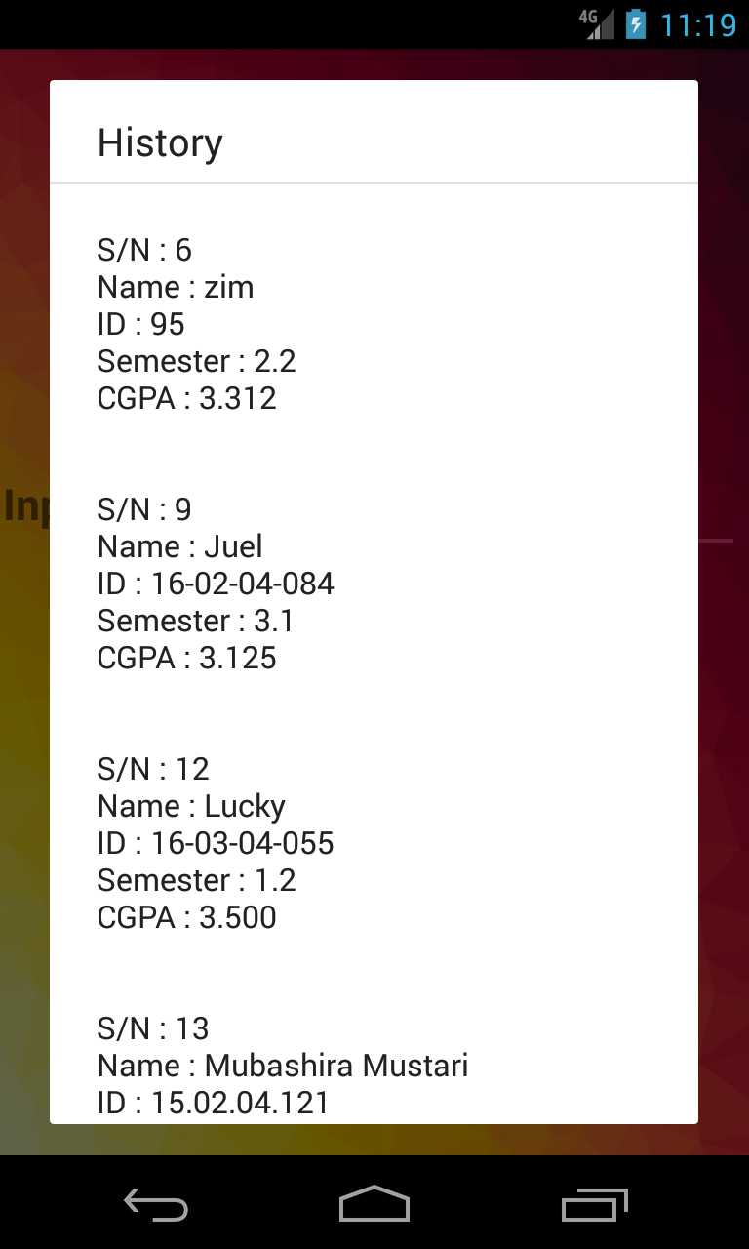
History
Page

Slide 8
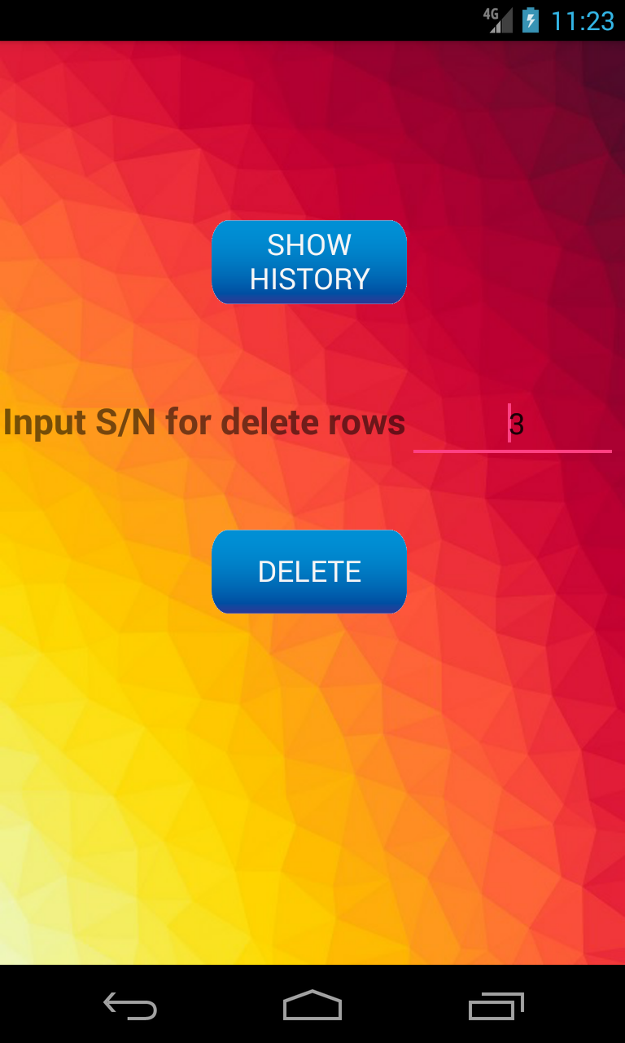
Deleting History
For delete a History from Database you have to press History Button then input the Serial Number of which history you want to delete then press Delete Button. That history will be deleted.

Slide 9
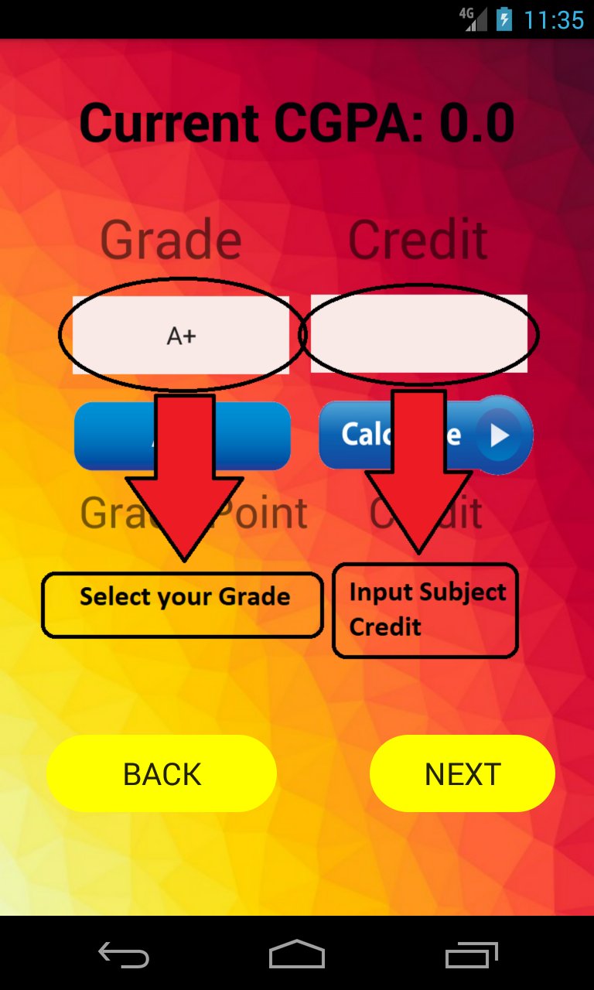
User Guide

Slide 10
SOFTWARES
Android Studio
Emulator
HARDWARES
PC/ Laptop
Android Smart Phones
END

